Slide 1
Download the Amanita eBook (PDF)
Or Read it Online
Chapter 6 – The Healer
Part 1

Slide 2
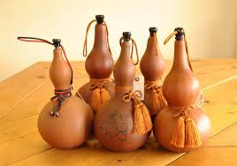
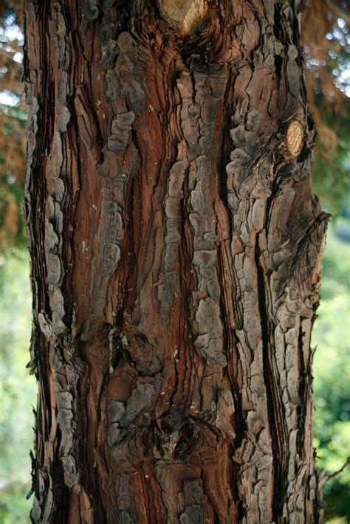
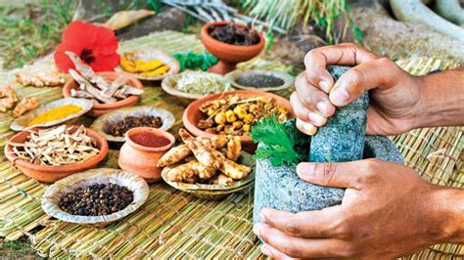
Chapter 6 – The Healer
Let’s begin by making sure we know the meaning of some important key words from the chapter. Since this chapter has many new words, we will split them into two parts for this lesson. Here is the first part:
Page 16:
unconscious (adj.)
happenstance (n)
divine (adj.)
providence (n)
woodsman (n)
[river]bank (n)
frail (adj.)
gourd (n)
abode (n)
solitary (adj.)
solemn (adj.)
vitals (plural n)
calling (n)
restore (v)
Page 17:
patient (n)
hives (n)
restorative (adj.)
tonic (n)
essentials (n)
bark (n)
concoction (n)
brew (v)
pipe (n)
blessing (n, v)
paste (n)
Page 18:
filter (v)
strainer (n)
paled (adj.)
suffice (v)
replenish (v)
subside (v)
condition (n)
stabilize (v)
concern (n)
cleanse (v)
Notes:
20 min.

Slide 3
Chapter 6 – The Healer
Themes & Subjects
Let’s explore the following themes & subjects from this chapter. For Part 1 we will look at:
Natural & Herbal Remedies
Spirit Animals
In Part 2 we will continue with:
Native (Indigenous) Peoples, their beliefs & rituals
Chants, Rituals, & Potions
Shamanism
Realms of Existence
Notes:
2 min.

Slide 4
Chapter 6 – The Healer
Themes – Natural & Herbal Remedies
DICUSSION QUESTIONS:
Have your hear of TCM (Traditional Chinese Medicine)? If so, can you give some examples of some medicines or methods use to treat some illness or disease?
Do you know of some plants, herbs, spices, or other gifts from nature that can help with illness or injuries?
Have you tried any natural remedies? For what? Did they work?
Do doctors today encourage their patients to use natural remedies or do they seem to prefer to tell them to use some modern drugs and medicines?
Notes:
10-12 min.

Slide 5
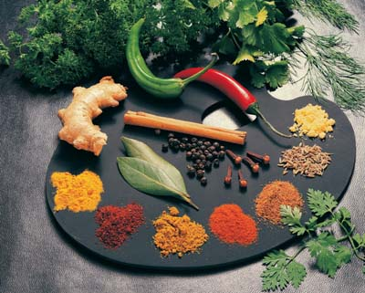
Chapter 6 – The Healer
Themes – Natural & Herbal Remedies
For thousands of years, peoples from around the world have used plants, herbs, flowers, fruits, vegetables, roots, seeds, and many other of nature’s gifts to help treat some illnesses, diseases, depression, cuts, injuries, and so on.
Let’s have a look at how some of these have been used and are used to great effect.
Notes:
2-3 min.

Slide 6
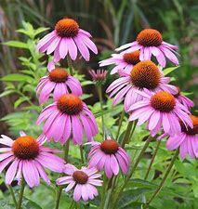
Themes – Natural & Herbal Remedies
Echinacea (purple coneflower)
Widely used to treat colds, the flu, sinus infection, bronchitis, and some types of infections.
It can also help boost the immune system.
It can also be used as a tonic to improve the liver's ability to reduce the effects of environmental toxins.
It was used by the Native Americans and adopted by the early settlers as an effective medicine.
It can be prepared as a tea, tincture, or in the form of pills.
Notes:
4-5 min.
https://health.howstuffworks.com/wellness/natural-medicine/herbal-remedies/echinacea-herbal-remedies.htm

Slide 7
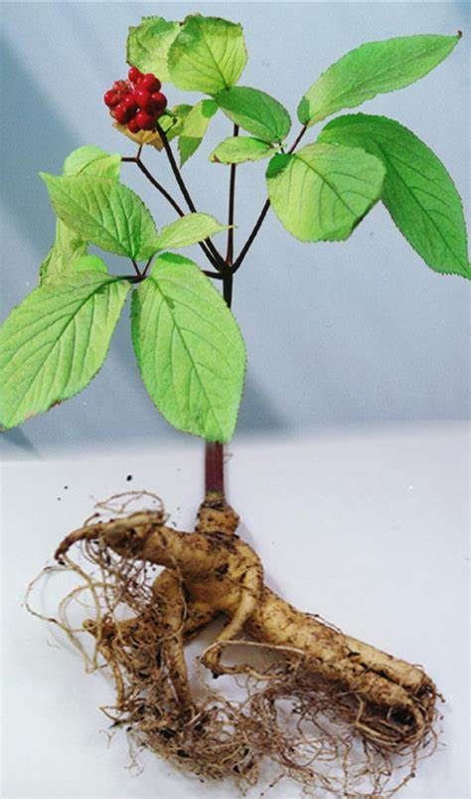
Themes – Natural & Herbal Remedies
Ginseng (flower & root)
Ginseng has been used in China for over 2000 years.
It is widely grown there and also in Korea, the United States and elsewhere.
Rather than being used for a specific treatment, it is used as a remedy for people who are fatigued (tired) and have low energy or feel weak, are stressed, and repeatedly get colds and the flu.
It helps to reduce stress and help bodily functions return to normal.
Though there are many ways to prepare it, one way is to dry thin slices of its root for consumption in tea.
Notes:
4-5 min.
https://health.howstuffworks.com/wellness/natural-medicine/herbal-remedies/ginseng-herbal-remedies.htm

Slide 8
Themes – Natural & Herbal Remedies
Cumin (spice made from seeds of the flowering plant)
Iron-rich Cumin is one of the most used spices in the world, and especially in India and Asia.
The ancient Egyptians used it in their cuisine and even in their mummification process. And the Greeks have been using it for over 5000 years.
Cumin seeds come from a flowering plant whose seeds are dried, grinded, and then used.
It has impressive health benefits including aiding digestion, helping with diabetes, weight loss, fighting bacteria and parasites, and preventing cancer.
It can also act as an anti-inflammatory and an immunity booster.
It can be prepared in a variety of ways, one including sprinkling its powder form on sliced potatoes before baking.
Notes:
4-5 min.
https://everipedia.org/wiki/lang_en/Cumin
https://www.dwarakaorganic.com/cumin-a-natural-remedy/
https://www.naturalfoodseries.com/13-cumin-seeds-benefits/
https://www.emedihealth.com/cumin-benefits.html
https://chopra.com/articles/8-health-benefits-of-cumin
https://earthycures.com/2019/09/07/cumin-seeds-a-remedy-for-many-illnesses/

Slide 9
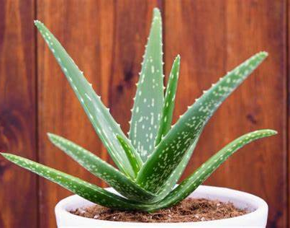
Themes – Natural & Herbal Remedies
Aloe Vera (medicinal plant)
Aloe Vero is a very versatile and popular plant that is used for multiple purposes around the world.
It is used to treat skin ailments such as cuts, burns, rashes, dry skin, eczema, and sunburns.
It is a key ingredient in many beauty and skin care products such as lotions to soften and moisturize the skin.
It is very safe for use on children.
Lets’ watch 2 videos: How it can be used to treat sunburns & 10 ways it can be used.
Notes:
10 min.
https://health.howstuffworks.com/wellness/natural-medicine/herbal-remedies/aloe-vera-herbal-remedies.htm
Videos:
- How to Use Fresh Aloe for Sunburns (1 min.)
https://www.youtube.com/watch?v=QuGAXOUBz1w
- 10 WAYS TO USE ALOE VERA || HEALTH AND BEAUTY BENEFITS (6:30 min.)
https://www.youtube.com/watch?v=VmU4ACZhu88
on Youku: https://v.youku.com/v_show/id_XNDgwMTQ5MzI4OA==.html

Slide 10
Themes – Natural & Herbal Remedies
Learn More…
The following websites provide some interesting sources from which you can learn more about natural remedies and which illnesses, diseases, and conditions they can help with.
Howstuffworks.com – Health – Herbal Remedies https://health.howstuffworks.com/wellness/natural-medicine/herbal-remedies/herbal-remedies.htm
StyleCaster – 50 Natural Ways to Fix Every Common Health Problem https://stylecaster.com/beauty/natural-remedies-for-every-common-health-problem/
Earth Clinic https://www.earthclinic.com/
Home Remedies for You https://www.home-remedies-for-you.com/
Healthline – Homegrown Herbal Remedies https://www.healthline.com/health/herbal-remedies-from-your-garden
Healthline – 10 Delicious Herbs and Spices With Powerful Health Benefits https://www.healthline.com/nutrition/10-healthy-herbs-and-spices#TOC_TITLE_HDR_2
WebMD – Home Remedies: What Works? https://www.webmd.com/balance/ss/slideshow-home-remedies
Notes:
2 min.

Slide 11
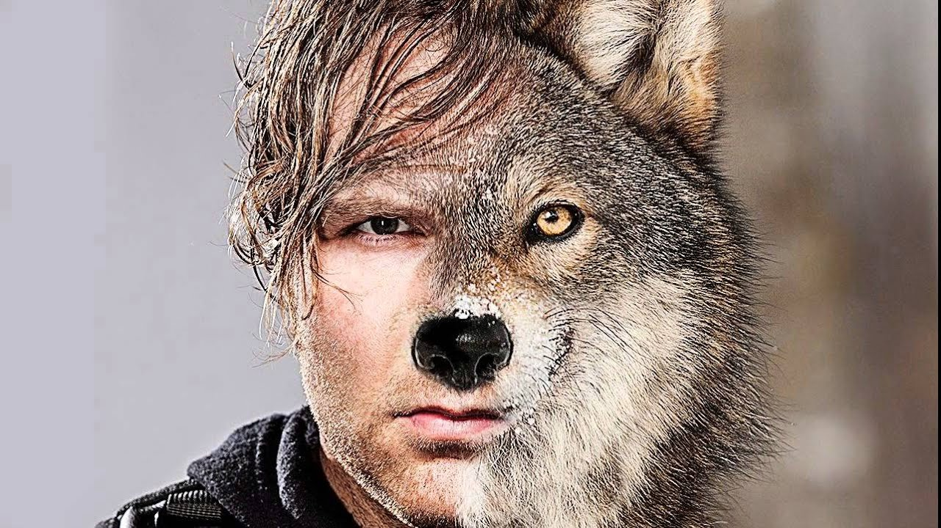
Chapter 6 – The Healer
Themes – Spirit Animals
What are Spirit Animals?
Before understanding what Spirit Animals are all about we must first examine our own spirit.
Our spirit, sometimes called our soul, is our life essence and is what gives us energy, drive, and what makes each and every one of us unique and special.
As humans we are always striving to know more about ourselves (self-understanding) and what lies in our conscious (and subconscious) mind.
A Spirit Animal can connect us more intimately with nature and ourselves.
They can guide us in times of uncertainty, doubt, and challenge and help us to be become better. They can provide us with insight.
Our existence has always been linked with the natural world, including the animal kingdom.
Notes:
6-8 min.
https://www.dictionary.com/e/slang/spirit-animal/
- The 25 Spirit Animals & Their Meanings, https://educateinspirechange.org/nature/animals/25-spirit-animals-amazing-meanings-behind/
- Spirit Animals — How They Are Connected To Our Existence, https://higherselfportal.com/spirit-animals-how-they-are-connected-to-our-existence/

Slide 12
Chapter 6 – The Healer
Themes – Spirit Animals
What are Spirit Animals?
Now we can answer this important question.
In many spiritual traditions and cultures, a spirit animal refers to a spirit that can help guide and protect us on our journeys.
Different animals have different characteristics. For examples, dogs are known to be very loyal while cats are more independent.
We will easily tend to share many characteristics with a particular animal.

Slide 13
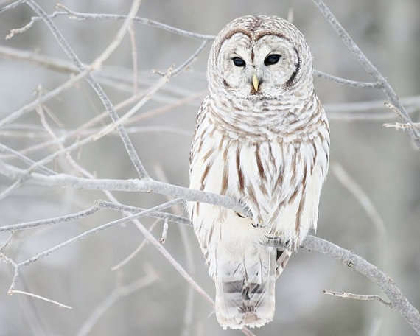
Themes – Spirit Animals
At the final paragraph of Chapter 6 – The Healer of Amanita, the following passage about how the woodsman experienced a strong connection with an animal – a white owl.
Who knows how long had elapsed before the man awoke in a dazed plight. Trying to focus his eyes was tricky, as the snowy surroundings was blinding him fiercely against a cloudy white sky. Yet, as he was slowly regaining his focus, his line of sight fell directly upon the large eyes of a white owl perched against the birch tree on which he had hung his ribbons. It’s as if there was some kind of mental or spiritual connection between the two beings. It was an auspicious sign, for owls had always held a special place in his heart and were very similar in nature to him considering he was also a solitary and quiet soul.
QUESTIONS:
What characteristics did the woodsman share with the owl?
What did the woodsman think of this chance meeting with the owl?
Notes:
12 min.

Slide 14
Themes – Spirit Animals
An owl as a spirit animal.
What are some qualities and characteristics of owls?
How can these relate or be meaningful to humans?
According to the 25 Spirit Animals website referred to earlier, the owl:
The other website What is my spirit animal also offers a lot of insight about the owl through its web page and video.
Notes:
10-12 min.
https://educateinspirechange.org/nature/animals/25-spirit-animals-amazing-meanings-behind/
https://whatismyspiritanimal.com/spirit-totem-power-animal-meanings/birds/owl-symbolism-meaning/
Video (6 min.) (saved): https://www.youtube.com/watch?v=BvEPlZsq07A
on Youku: https://v.youku.com/v_show/id_XNDgwMTQ5ODYyOA==.html

Slide 15
Chapter 6 – The Healer
Themes – Spirit Animals
What is my Animal Spirit?
You need to examine the characteristics of different types of animals (not only mammals but also reptiles, insects, and fish or other water creatures).
An animal for which you share several characteristics can be considered your animal spirit. Which one most resembles your character?
Also, your animal spirit can change and if you’ve recently have encountered a particular animal (in your life, dreams, thoughts) then it is likely that the creature is calling upon to offer guidance and direction.
Many websites offer some information about the characteristics of spirit animals.
The 25 Spirit Animals & Their Meanings
What is my Spirit Animal? How to Find your Spirit Animal
Spirit Animals — How They Are Connected To Our Existence
Notes:
5-6 min.
https://educateinspirechange.org/nature/animals/25-spirit-animals-amazing-meanings-behind/
https://whatismyspiritanimal.com/how-to-find-your-spirit-animal-complete-guide/
https://higherselfportal.com/spirit-animals-how-they-are-connected-to-our-existence/
https://whatismyspiritanimal.com/spirit-animal-quiz/

Slide 16
Themes – Spirit Animals
Finding out what your spirit animal is.
Go to the following web page to research which animal is most likely to be your spirit guide.
https://whatismyspiritanimal.com/how-to-find-your-spirit-animal-complete-guide/
There is a lot of information and even a quiz you can take to help you.
Notes:
https://whatismyspiritanimal.com/how-to-find-your-spirit-animal-complete-guide/

