Slide 1
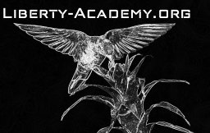
Download the Amanita eBook (PDF)
Or Read it Online
Chapter 6 – The Healer
Part 2

Slide 2
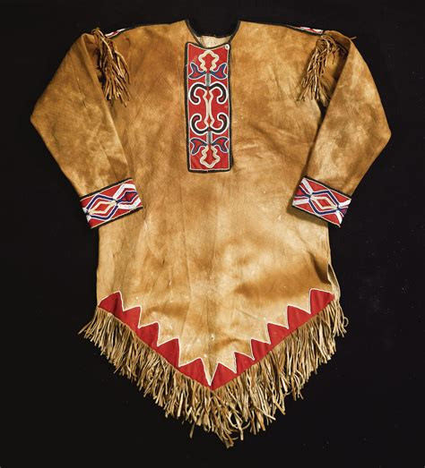
Chapter 6 – The Healer
Let’s begin by making sure we know the meaning of some important key words from the chapter. Since this chapter has many new words, we will split them into two parts for this lesson. Here is the second part:
Page 20:
rum (n)
simmer (v)
potion (n)
ineffective (adj.)
retrieve (v)
tunic (n)
garment (n)
hide (n)
garb (n)
adorn (v)
peculiar (adj.)
motif (n)
tassel (n)
native [peoples] (n)
assortment (n)
Page 19:
curiosity (n)
radiate (v)
identical (adj.)
exception (n)
occasional (adj.)
moan (n)
recovery (n)
disturbance (n)
surface (n)
dormant (adj.)
unworldly (adj.)
Page 19 (cont’d):
measure (n)
swoon (n)
potency (n)
tincture (n)
generous (adj.)
dose (n)
reserve (n)
Notes:
15 min.

Slide 3
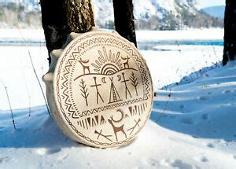
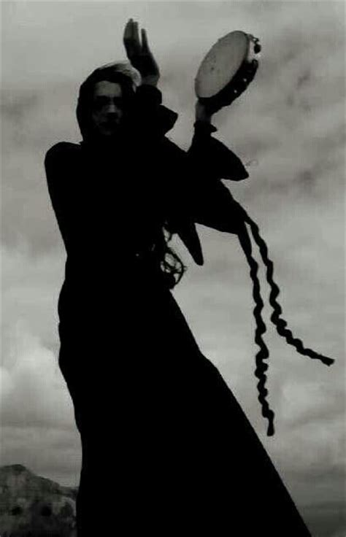
Chapter 6 – The Healer
Let’s begin by making sure we know the meaning of some important key words from the chapter. since this chapter has many new words, we will split them into two parts for this lesson. Here is the second part:
Page 21:
tambourine (n)
faded (adj.)
imprint (n)
resemble (v)
fetch (v)
rattle (n)
reserve (n)
encampment (n)
rage (v)
blaze (n)
birch [tree] (n)
gust (n)
forthcoming (adj.)
bonfire (n)
Page 22:
consume (v)
generous (adj.)
interval (n)
chant (n)
awkward (adj.)
tamer (v)
frenzy (n)
bout (n)
dizziness (n)
elapse (v)
dazed (adj.)
focus (n)
auspicious (adj.)
Notes:
15 min.

Slide 4
Chapter 6 – The Healer
Themes & Subjects
Let’s explore the following themes & subjects from this chapter:
For Part 1 we looked at:
Natural & Herbal Remedies
Spirit Animals
In Part 2 we will continue with:
Native (Indigenous) Peoples, their beliefs & rituals
Chants, Rituals, & Potions
Shamanism
Realms of Existence
Notes:
1 min.

Slide 5
Chapter 6 – The Healer
Themes – Native (Indigenous) Peoples, their beliefs & rituals
Indigenous refers to either the original inhabitants (people) of a place, region, or country, or something (such as plants and animals) growing or living there.
Native and aboriginal are synonyms that are also often used to describe people, plants, animals, or other things that are particular to a certain area.
A tribe is also used to describe a group of people, often of related families, who live together sharing the same language, culture, and customs.
Tribes generally do not live in towns or cities but rather in their native land.
Ethnic groups are people of the same race who share a distinct culture.
For example, there are 56 ethnic groups in China.
Notes:
5-6 min.
http://en.people.cn/102759/202921/index.html

Slide 6
Themes – Native (Indigenous) Peoples, their beliefs & rituals
There are hundreds, if not thousands, of distinct tribes or aboriginal peoples all around the world.
Wikipedia has an extensive list of them on their ‘List of Indigenous Peoples’ organized by country and region.
Three interesting articles about tribes/indigenous people include:
Woo! Jr. Kids – Indigenous Peoples Around The World
Kickassfacts.com – 20 Tribes From Around the World
ScoopWhoop – 10 of the Last Remaining Tribes from Around The World
These are all must-read articles, as they show the rich culture and traditions of these fascinating tribes.
Kazakhs
Goroka
Notes:
5 min.
https://en.wikipedia.org/wiki/List_of_indigenous_peoples
https://www.woojr.com/indigenous-peoples-around-the-world/
https://www.kickassfacts.com/20-tribes-from-around-the-world/
https://www.scoopwhoop.com/inothernews/unknown-tribes-of-the-world/

Slide 7
Themes – Native (Indigenous) Peoples, their beliefs & rituals
Example
Let’s explore one tribe in particular called the Kazakhs who are primarily located in Mongolia.
Here are descriptions from two of the articles mentioned in the previous slide:
The Kazakhs are the descendants of Turkic, Mongolic and Indo-Iranian tribes and Huns that populated the territory between Siberia and the Black Sea. They are a semi-nomadic people and have roamed the mountains and valleys of western Mongolia with their herds since the 19th century. – Kissassfacts.com
These semi-nomadic tribes are direct descendants of the Huns. They have maintained their foothold over the valleys of Mongolia since the 19 th century and are notable for herding. The Kazakhs are known for their prowess in the ancient art of eagle-hunting, something that they have perfected over time. – ScoopWhoop
Notes:
6 min.
https://www.kickassfacts.com/20-tribes-from-around-the-world/
https://www.scoopwhoop.com/inothernews/unknown-tribes-of-the-world/

Slide 8
Chapter 6 – The Healer
Themes – Chants, Rituals, & Potions
Many tribes or indigenous peoples’ traditions involve the use of interesting chants, rituals, and even potions that are used for various purposes ranging from healing the sick to contacting spirits in other realms.
Chants are like songs sung by one or more people and act similar to spells in that they can attract or change a situation.
Rituals are performed across all cultures and for all kinds of reasons. For example, marriage rituals are quite common to ensure good luck to the bride and groom.
And potions are concoctions that are made from various ingredients – both solid and liquid. They usually have healing, magical, or poisonous properties and thus must be used with caution and precision. Many plants, natural herbs, and spices have both medicinal and supernatural qualities.
Notes:
5 min.

Slide 9
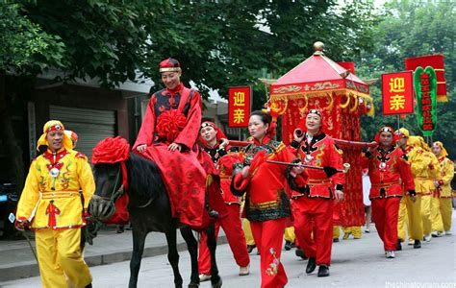
Chants, Rituals, & Potions - Examples
Chants
The following chant is called ‘Summer Solstice Power Chant’ which is popular all around the world:
We are the power in everyone,
We are the dance of the Moon and Sun,
We are the hope that will not hide,
We are the turning of the tide.
Rituals
In China, a marriage ritual is held whereby the bride is carried from her home in a sedan chair. When leaving her home, her feet must not touch the ground until she disembarks at the location of the wedding ceremony where she meets the groom.
Notes:
4 min.

Slide 10
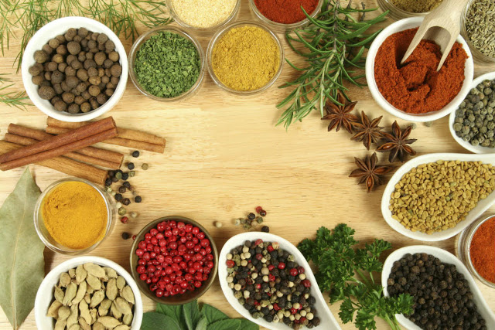
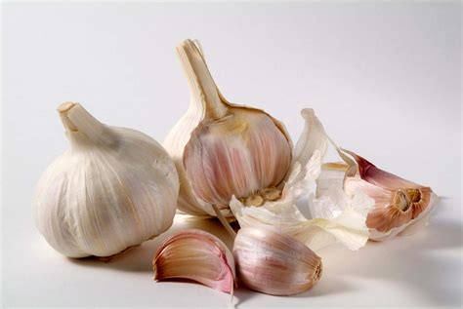
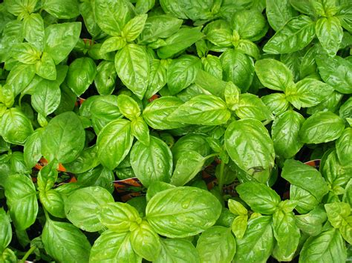
Chants, Rituals, & Potions - Examples
Potions
There exist an incredible amount of potions or concoctions that are used from indigenous tribes around the world.
Individual ingredients are also believed to hold supernatural or magical properties.
Here are some examples:
Garlic has been used for centuries as protection against evil spirits, thieves, enemies, and sorcerers.
Since ancient times Basil has been used in the arts of magic and divination of love. Basil is used in spells to increase well-being, repel evil, exorcise ghosts and demons of haunted places and possessed people, as well as attract good luck.
Notes:
5 min.
Handout – Chants_Rituals_&_Potions.docx
website – Health Benefits of Basil http://eathealthylivefit.com/2016/05/health-benefits-of-basil/

Slide 11
Chapter 6 – The Healer
Themes – Native (Indigenous) Peoples, their beliefs & rituals
Shamanism
Now we will explore shamanism, shamans, and shamanic traditions.
Certain tribes have special people called shamans.
A shaman is someone who has the power or ability to communicate with spirits for the purpose of healing the sick.
Shamans can act as a bridge between the material world and the spirit world.
Shamanism is generally recognized as a kind of religion practiced by certain indigenous peoples.
Shamanism not only involves communication with good and evil spirits, but also espouses a closeness to nature.
Shamanistic traditions consist of practices and rituals held by shamans and those who believe in shamanism.
Notes:
5-6 min.

Slide 12
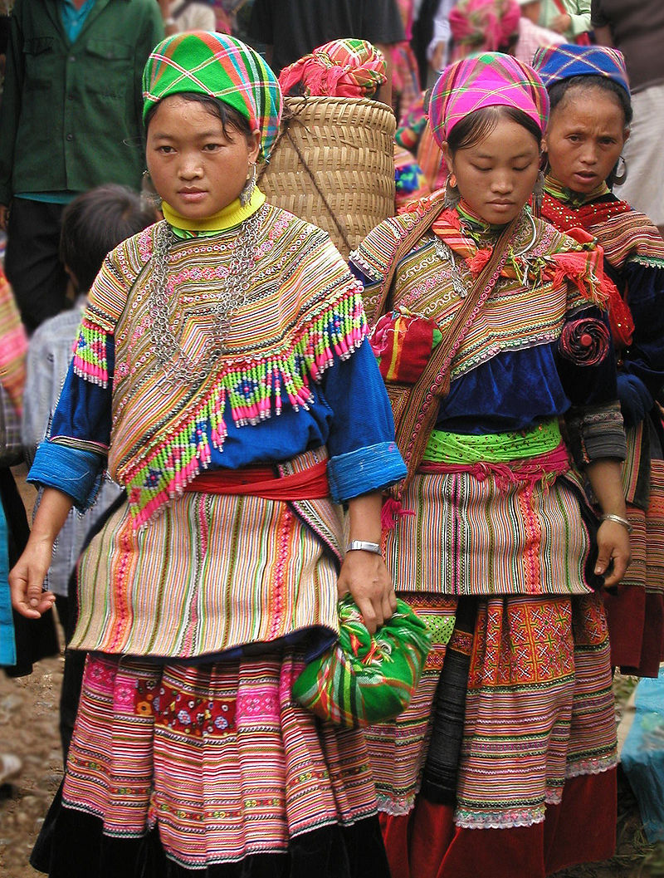
Shamanism
Shamans from different parts of the world will differ in their respective rituals and ways of reaching spirits.
An interesting article entitled ‘Top 10 Indigenous Tribes with Shamanic Traditions’ showcases some very fascinating ones.
Let’s have a look at two in particular: the Hmong peoples and the Mongolian shamans.
First, the Hmong people (a subgroup of the Miao people of China) who can be found in Southern China, Vietnam, Thailand, and Myanmar.
From the article:
5000 years ago the Hmong people of China practiced a form of spiritualism called “Ua Neeb.” This form of spiritual healing said that all souls are interchangeable. This tribe practiced a respectful form of animal sacrifice in order to heal someone.
The reasoning was that since all souls were interchangeable, asking permission to use the animal’s soul was fine. The animal’s soul would heal the person, and all of this would be officiated by the shaman of the tribe; he would talk to the gods and ask the animal for permission.
Videos: Hmong Shaman Performs Healing Ritual (1:19) and, from National Geographic, Shaman Performs Rite to Protect a Man’s Soul From the Underworld (1:34)
Notes:
8 min.
https://psy-minds.com/indigenous-tribes-shamanic-traditions/
Hmong: https://en.wikipedia.org/wiki/Hmong_people
Miao: http://en.people.cn/102759/7567633.html
Videos:
- Hmong Shaman Performs Healing Ritual, by Niftic, https://www.youtube.com/watch?v=e3rtdkZNy1Q
- Shaman Performs Rite to Protect a Man’s Soul From the Underworld, by National Geographic, https://www.youtube.com/watch?v=3UxIXIi1kR0

Slide 13
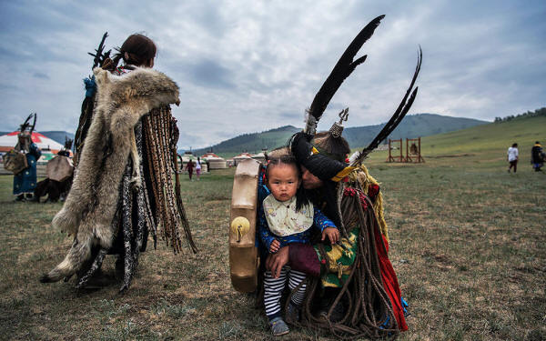
Shamanism
As a second example, we have the Mongolian shaman.
From the article:
In Mongolia having a shaman is still common today. The shaman would (and still does!) call down rain, drive out evil spirits, and call upon the good spirits for healing and guidance.
The shaman calls upon several different versions of spirits; some spirits are protectors, some are ancestral spirits, some are the spirits of a great shaman of the past, and some are devils and evil spirits.
The shaman has to call upon all of them, either to call for help, guidance, and healing, or to order them to leave and do no harm.
Videos: A Mongolian shaman in atheist China (3:08) and Ceremony - Mongolian Shaman (2:53)
A Mongolian shaman or böö sits with his child before a fire ritual during the summer solstice in June 2018 outside Ulaanbaatar.
Notes:
8-9 min.
Articles:
- The Guardian - Former herder reveals perils of being a shaman in atheist China, https://www.theguardian.com/world/2013/sep/20/china-mongolia-shaman-mining-town
- Sacred Sites of Mongolian Shamanism, https://sacredsites.com/asia/mongolia/mongolian_shamanism.html
- Additional photographs), https://sacredsites.com/asia/mongolia/mongolian_shamanism_additional_photos.html
Image source: BibliotecaPleyades.net – Shamanism, https://www.bibliotecapleyades.net/cienciareal/esp_chaman_52.htm
Videos:
- A Mongolian shaman in atheist China, by The Guardian, https://www.youtube.com/watch?v=UlOMzHMG73c
- Ceremony - Mongolian Shaman by Thomas Simoen (Around Khosgol Lake - Mongolia), https://www.youtube.com/watch?v=JHa0ToOe0dE

Slide 14
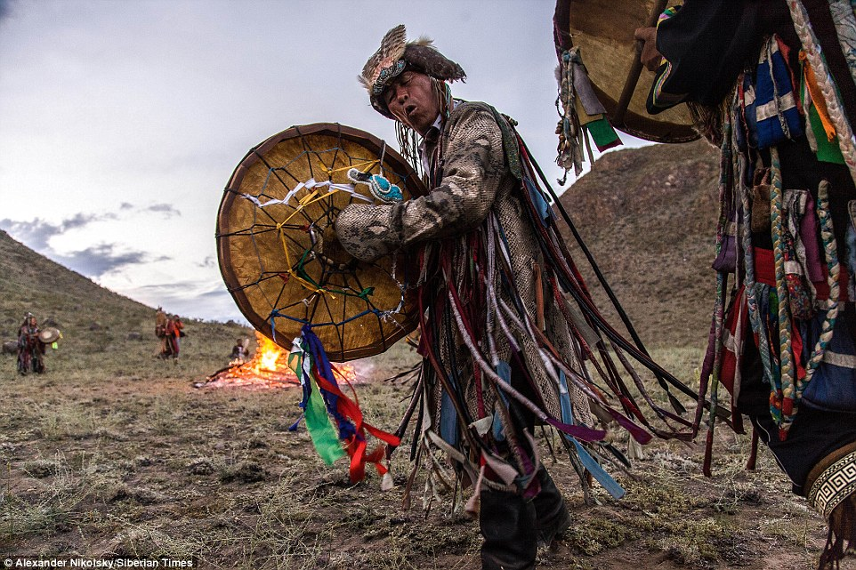
Shamanism
Also not too far from Mongolia in Siberia, Siberian Shamanism is widely practiced.
Here are some stunning photographs featured in an article by The Siberian Times entitled Shamans rouse the ancient Siberian spirits; in them you can see the shamans in ritual at a festival, named 'Call of 13 Shamans’ that was held in an area of Siberia during the summer of 2014.
Notes:
3 min.
Article:
- The Siberian Times - Shamans rouse the ancient Siberian spirits, http://siberiantimes.com/other/others/features/shamans-rouse-the-ancient-siberian-spirits/

Slide 15
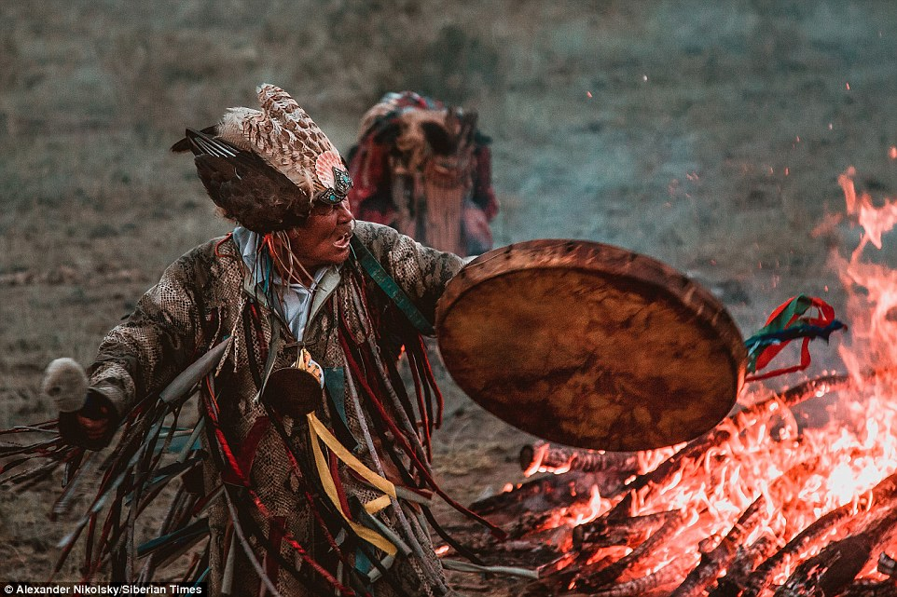

Slide 16
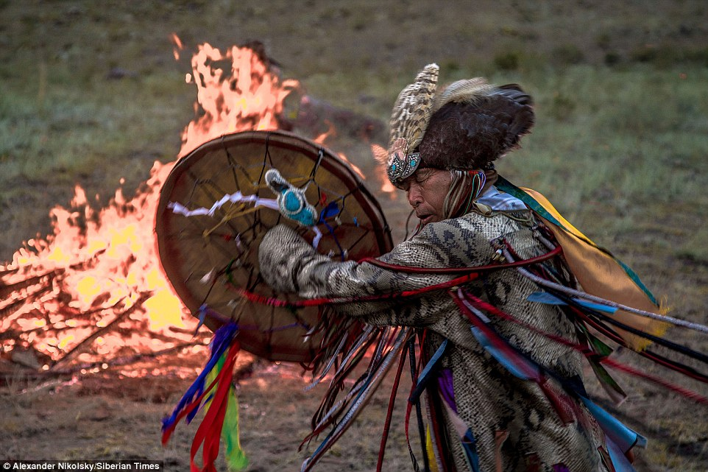

Slide 17
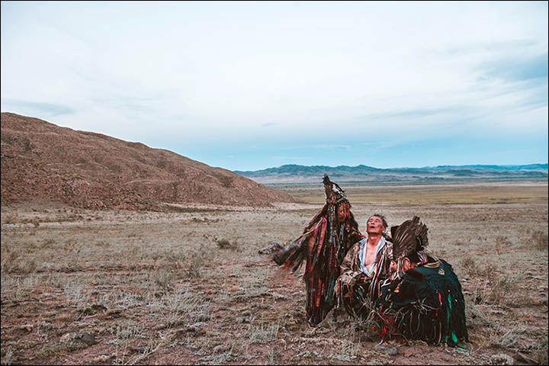

Slide 18
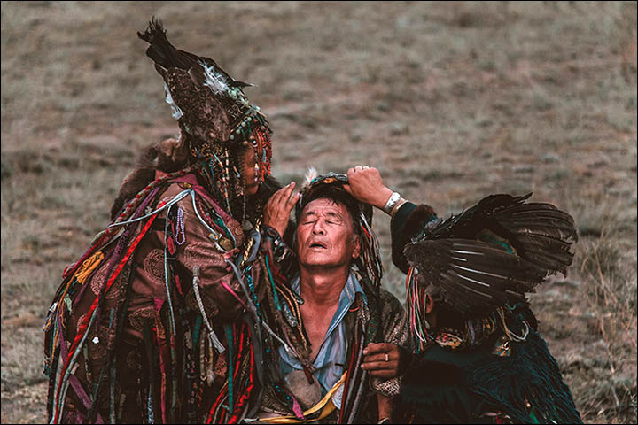

Slide 19
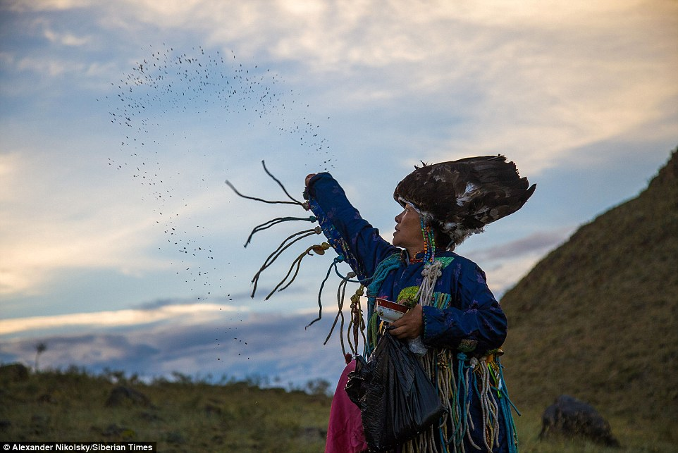

Slide 20
Chapter 6 – The Healer
Themes – Realms of Existence
Before looking at this theme, let’s contemplate with a few questions:
How do we know we exist? What does it mean to exist?
Where do we exist?
How do we know our world is real?
Is everything we “perceive” from the world only in our minds? How can we be sure?
What happens to us when we die?
Do other worlds exist that we may not know about?
Notes:
12-15 min.

Slide 21
Chapter 6 – The Healer
Themes – Realms of Existence
What is a realm?
Most dictionary definitions fail to properly define realm in the context of existence.
To keep things simple, let’s define the term as follows: realm: a “place” where tangible and/or intangible things reside.
By tangible, I mean like something physical or material such as a rock, a tree, water, and which can include the human body.
By intangible, I mean things that cannot be physically touched like love, hate, a thought, faith, a spirit or soul, consciousness, dreams, ghosts, demons, gods, and angels.
“Things” can include tangibles and intangibles.
By reside, I mean where they are present – whether temporarily or permanently.
Notes:
4 min.

Slide 22
Chapter 6 – The Healer
Themes – Realms of Existence
In most civilizations around the world, there are 3 realms that seem to be commonly recognized:
Earthly realm
Heavenly realm
Hell
Notes:
1 min.
https://www.cbsnews.com/news/how-we-see-heaven-and-hell/

Slide 23
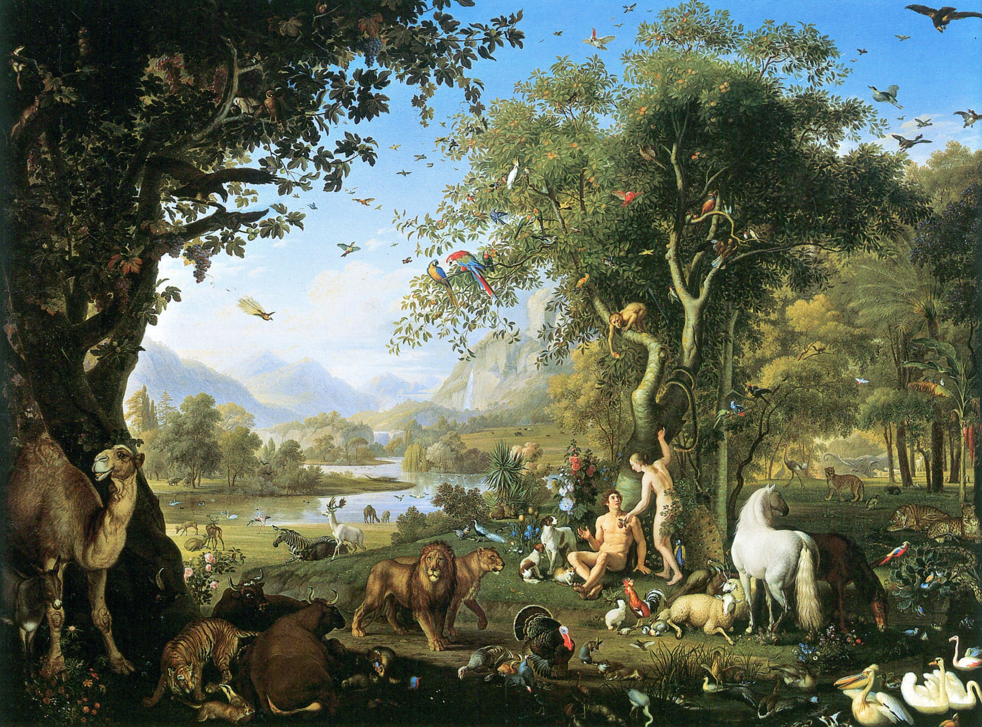
Themes – Realms of Existence
Earthly realm – The physical world in which we live, our planet.
Adam and Eve in the Garden of Eden (by Peter Wenzel)
Notes:
2 min.
1 - Earthly (best art):
Wenzel Peter, Adam and Eve in the Garden of Eden
https://biblicalmiracles.blogspot.com/2011/12/adam-and-eve-in-garden-of-eden.html
http://www.museivaticani.va/content/museivaticani/en/collezioni/musei/la-pinacoteca/sala-xvi---secolo-xix/wenzel-peter--adamo-ed-eva-nel-paradiso-terrestre.html
https://www.pinterest.com/pin/335799715937826305/
http://www.artcyclopedia.com/artists/peter_wenzel.html

Slide 24
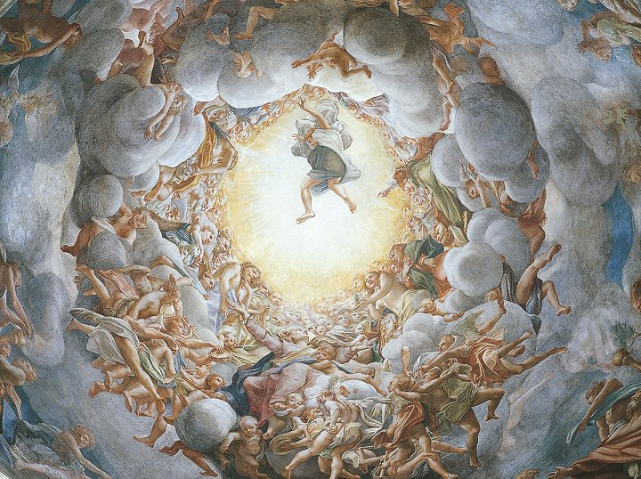
Themes – Realms of Existence
Heavenly realm – (sometimes referred to as Celestial realm) – a spiritual realm believed to be where God, angels, and other celestial beings reside as well as where good people are thought to go after their death (heaven).
Part of a ceiling fresco painting: Assumption of the Virgin (by Antonio Allegri da Correggio) in in Parma Cathedral (Italy), 1530
Notes:
2 min.
2 - Heaven (best art):
Assumption of the virgin correggio:
https://smarthistory.org/correggio-assumption-of-the-virgin/
https://www.khanacademy.org/humanities/renaissance-reformation/high-ren-florence-rome/late-renaissance-venice/a/correggio-assumption-of-the-virgin
http://www.visual-arts-cork.com/famous-paintings/assumption-correggio.htm
https://classconnection.s3.amazonaws.com/399/flashcards/510399/jpg/20-191310402924587.jpg
https://duckduckgo.com/?q=assumption+of+the+virgin+correggio&t=h_&iar=images&iax=images&ia=images&iai=http%3A%2F%2Fimages.traditionalhome.mdpcdn.com%2Fsites%2Ftraditionalhome.com%2Ffiles%2Farticle%2Fcupoladicorreggio.jpg
https://www.studyblue.com/notes/note/n/chapter-20/deck/996452

Slide 25
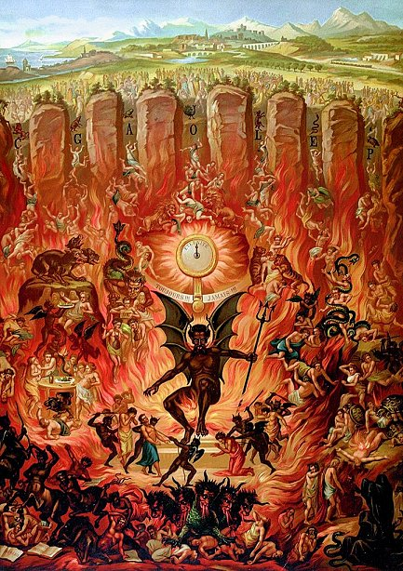
Themes – Realms of Existence
Hell a spiritual realm of evil and suffering where the devil, demons, and wicked or condemned souls are sent to be punished after death.
The Seven Gates of Hell (painter unknown, possibly from a Tarot deck)
Notes:
2 min.
3 - Hell (best art):
Seven Gates to Hell (author - not sure?)
http://pre-gebelin.blogspot.com/2012/08/the-first-tarot-aficionado.html
https://www.pinterest.com/pin/432486370438036395/

Slide 26
Chapter 6 – The Healer
Discussion Questions for this chapter
DISCUSSION QUESTIONS:
Where do you think the woodsman is from?
So far, do you think the woodsman’s various tonics and concoctions are helping Amanita to heal? How so?
Amanita continues to have dreams and in this chapter; she dreams of some kind of being that talked to her while she was ascending the cliff.
What was this being?
Where did it come from?
What did it tell her?
Some people consider the place where we dream as a realm in and of itself. Do you agree or disagree? Why?
Notes:
8-12 min.

