Slide 1
Download the Amanita eBook (PDF)
Or Read it Online
Chapter 7 – The Renewal
Part 1

Slide 2
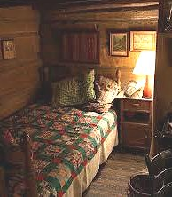
Chapter 7 – The Renewal
Let’s begin by making sure we know the meaning of some important key words from the chapter. Since this chapter has many new words, we will split them into two parts for this lesson. Here is the first part:
Page 25:
creator (n)
protector (n)
shake (v)
worryingly (adv.)
pensive (adj.)
dormant (adj.)
nutrition (n)
porridge (n)
elevated (adj.)
hollow-out (ph. v)
pliable (adj.)
channel (v)
hitch (n)
Page 25 (cont’d):
dusk (n)
gaze (v)
surreal (adj.)
spectacle (n)
perch (v)
Page 24:
exhausted (adj.)
cot (n)
moan (v)
exhale (v)
sigh (n)
eerily (adv.)
bizarre (adj.)
odd (adj.)
being (n)
angelic (adj.)
glimmer (v)
ray (n)
blissful (adj.)
Page 26:
peak (n)
afar (adv.)
subtle (adj.)
adjacent (adj.)
lunge (v)
leap (v)
Notes:
20 min.

Slide 3
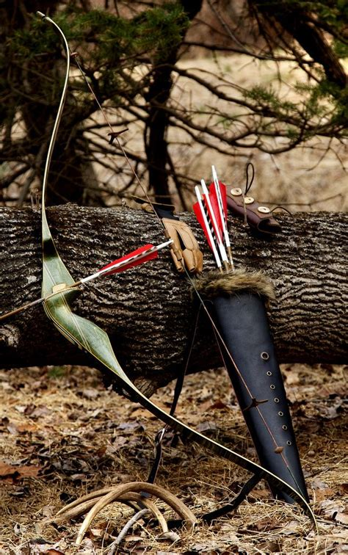
Chapter 7 – The Renewal
Let’s begin by making sure we know the meaning of some important key words from the chapter. Since this chapter has many new words, we will split them into two parts for this lesson. Here is the first part:
Page 26 (cont’d):
pursuit (n)
opportune (adj.)
rapid (adj.)
glide (v)
swerve (v)
futile (adj.)
swiftly (adj.)
grasp (v)
claw (n)
propel (v)
Page 26 (cont’d):
majestic (adj.)
heaven (n)
ascend (v)
depose (v)
inanimate (adj.)
bow (n)

Slide 4
Chapter 7 – The Renewal
Themes & Subjects
Let’s explore the following themes & subjects from this chapter. For Part 1 we will look at:
Dreams
Angels
In Part 2 we will continue with:
The Future, Predicting the Future
Story Resolution & Discussion
Notes:
2 min.

Slide 5
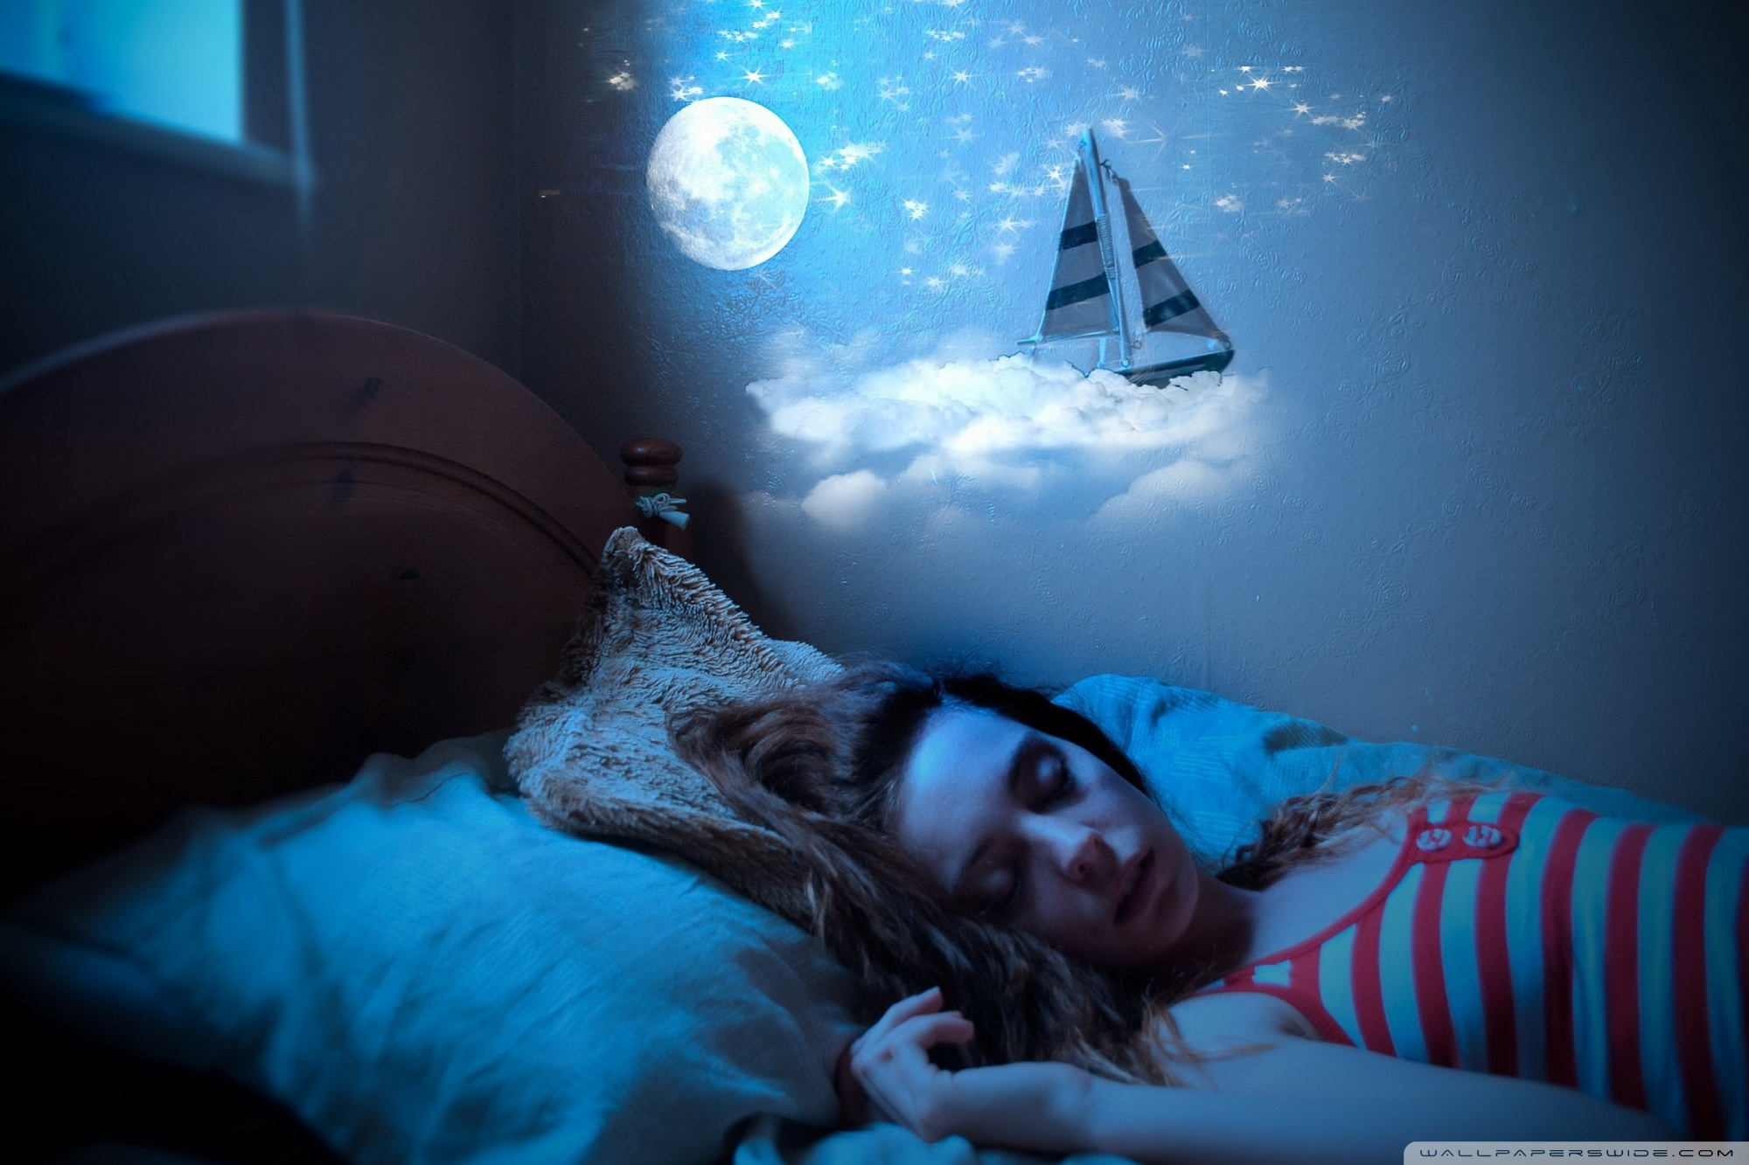
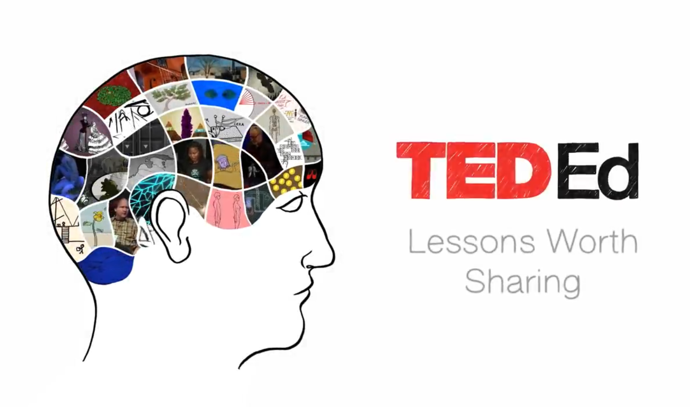
Chapter 7 – The Renewal
Themes – Dreams
DISCUSSION QUESTIONS:
Do you remember your dreams?
What did you dream about lately?
Do you sometimes get nightmares?
Have any of your dreams ever come true?
Did you ever have the same dream more than once?
Can we have the sensations of touch, taste, and smell in dreams?
Reading: Different Types of Dreams
Why do we dream? Can you think of 3 possible reasons?
Video: TED-Ed – Why do We dream?
Notes:
20 min.
1. Discussion Questions (1 to 6) (6-8 min.)
Reading Handout: Dreams.docx (6-8 min.)
Video: TED-Ed - Why do we dream? - Amy Adkins (5:37, saved)
https://www.youtube.com/watch?v=2W85Dwxx218
→ Reasons why we dream stated in the video: 1. to fulfill our (subconscious) wishes, 2. to remember. 3. to forget (unlearning, reverse-learning), 4. to keep our brains working, 5. to rehearse, 6. to heal, 7. to solve problems

Slide 6
Chapter 7 – The Renewal
Themes – Dreams
In chapter 7, Amanita has three vivid dreams. Let’s explore their contents to extract their deeper meanings.
Climbing on a cliff with an angelic being at her side (p. 24)
What ‘being’ may have been at her side?
What did the being mean when it said to Amanita: “You have nothing to worry about. Ever. For, your creator and protector is, and always has been, within you.” ?
Notes:
5 min.

Slide 7
Chapter 7 – The Renewal
Themes – Dreams
Dream of being an eagle capturing the boar (pp. 25-6)
How had Amanita’s senses and capabilities changed now that she was an eagle?
Why didn’t she kill the boar, but rather chose to depose the beast at the mouth of the cave?
Dream of Amanita with her daughter in the garden (pp. 27-8)
In your own words, describe the garden environment Amanita was in with her daughter.
What do you think is meant by the passage: “She couldn’t help but to think of how it all made sense now.” ? What made sense?
Notes:
8-10 min.

Slide 8
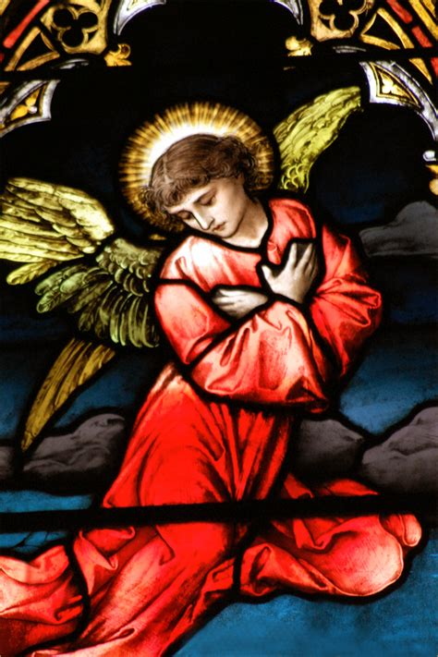
Chapter 7 – The Renewal
Themes – Angels
What are angels?
An angel is an eternal spirit created by God; it is a celestial or supernatural being that acts as an intermediary between God and humans.
The word ‘angel’ comes from the Greek word ‘aggelus’ which means ‘messenger’.
Angels have no physical bodies nor a specific gender, but are often depicted in bodily form with wings.
They exist in heaven and the spirit realm and can sometimes be seen or heard by people.
Notes:
3-4 min.

Slide 9
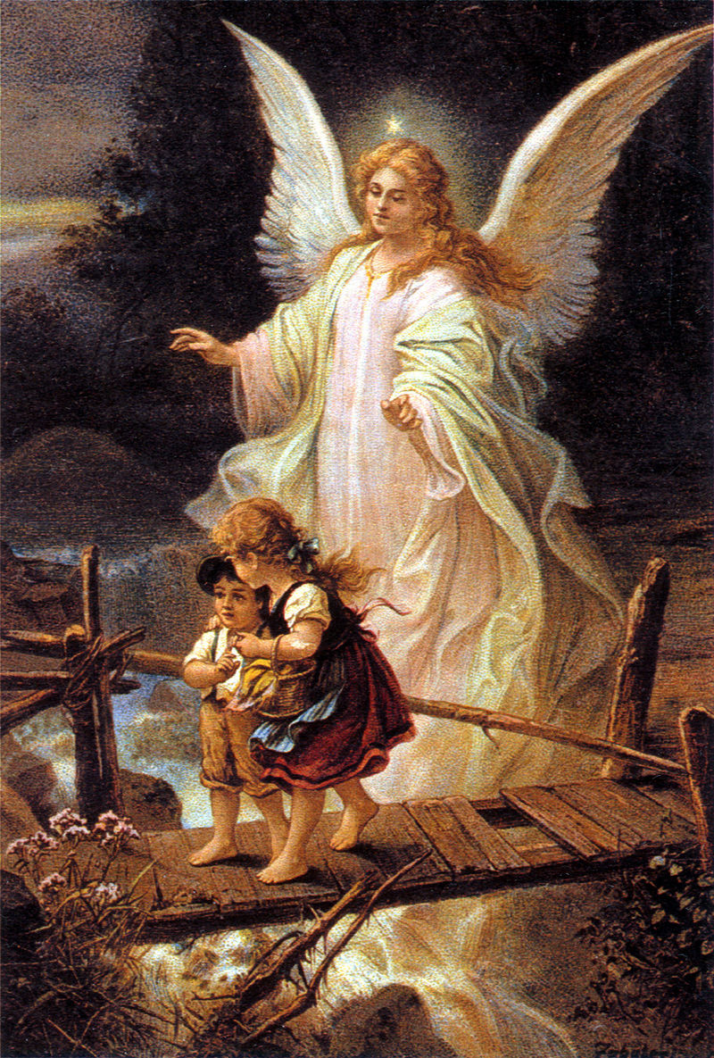
Themes – Angels
Though there are many types of angels, here are three that are commonly recognized:
Guardian Angels
A guardian angel is a spirit assigned by God that protects and looks after a specific person throughout their life.
People may not even be aware that they have a guardian angel, but its invisible force shields them from serious harm, including malevolent (evil) spirits.
Notes:
2-3 min.
Painting: https://en.wiktionary.org/wiki/guardian_angel
http://fatherjulian.blogspot.com/2014/10/guardian-angels.html
https://www.turnbacktogod.com/guardian-angel-pics/
Traditional Catholic Prayer to one’s Guardian Angel:-
Angel of God, my guardian dear to whom God’s love commits me here. Ever this day/night be at my side to light, to guard, to rule and guide. Amen.
7 Things You Should Know About Guardian Angels, https://www.mysticwayfarer.com/7-things-you-should-know-about-guardian-angels/

Slide 10
Themes – Angels
Though there are many types of angels, here are three that are commonly recognized:
Guardian Angels - Traditional Catholic Prayer to one’s Guardian Angel:
Angel of God, my guardian dear to whom God’s love commits me here. Ever this day/night be at my side to light, to guard, to rule and guide. Amen.
Notes:
2 min.
Traditional Catholic Prayer to one’s Guardian Angel:-
Angel of God, my guardian dear to whom God’s love commits me here. Ever this day/night be at my side to light, to guard, to rule and guide. Amen.

Slide 11
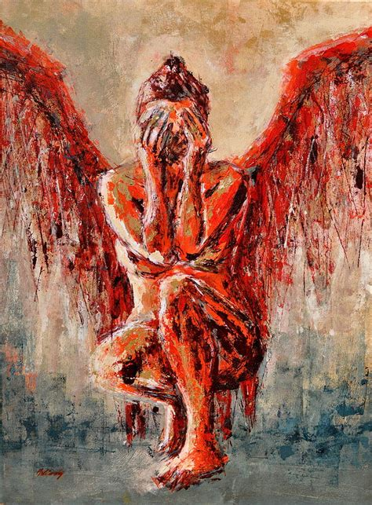
Themes – Angels
Though there are many types of angels, here are three that are commonly recognized:
Fallen Angels
A fallen angel is an angel that has disobeyed God, is banished from heaven, and punished to become a demon – a lesser, evil spirit.
Since all spirits are eternal, they cannot be destroyed; thusly, a demon will continue to exist in hell, but may still sometimes intervene in the physical world.
Notes:
2-3 min.
Painting: https://fin
Satan: https://occult-world.com/satan/, https://occult-world.com/devil/
Lucifer (often wrongly considered/labeled a ‘fallen’ angel): https://occult-world.com/lucifer/, https://occult-world.com/lucifer-light-bearer/
eartamerica.com/featured/fallen-angel-i-beata-belanszky-demko.html
http://www.redicecreations.com/specialreports/2005/11nov/lucifer.html
The only Bible reference to Lucifer: https://biblehub.com/hebrew/1966.htm

Slide 12
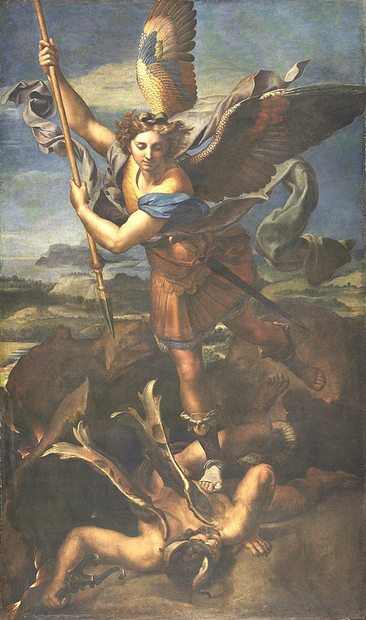
Themes – Angels
Archangels
An archangel is a higher order angel.
The word archangel comes from a Greek word ‘archangelos’ meaning ‘chief’ or ‘ruling’ angel; thusly, an archangel is a ‘chief messenger’.
In a way, archangels are in charge of heaven’s armies (of angels) to battle against demons, evil, and the devil (Satan – the leader of demons).
Michael, Gabriel, and Raphael are three commonly referenced archangels in several religions.
Painting ‘Saint Michael Vanquishing Satan’
by artist Raphael Sanzio, 1518
Notes:
2-3 min.
Painting: https://en.wikipedia.org/wiki/File:Le_Grand_Saint_Michel,_by_Raffaello_Sanzio,_from_C2RMF_retouched.jpg
https://www.etymonline.com/word/archangel#etymonline_v_16954
https://www.gotquestions.org/archangels.html
https://occult-world.com/archangels/
https://en.wikipedia.org/wiki/Archangel
https://www.holyart.com/blog/saints-and-blessed/archangels-who-are-they-and-what-is-their-function/
Satan: https://occult-world.com/satan/, https://occult-world.com/devil/
Lucifer (often wrongly considered/labeled a ‘fallen’ angel): https://occult-world.com/lucifer/

Slide 13
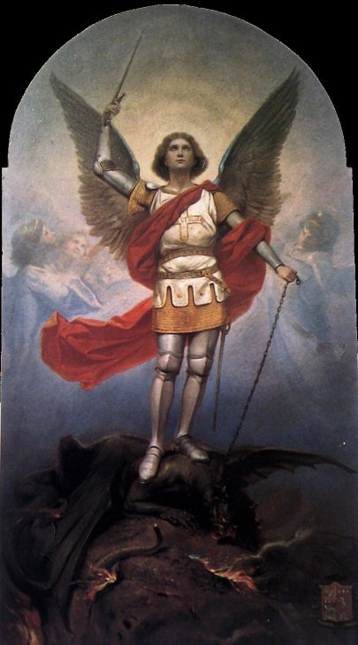
Themes – Angels
Archangels - Prayer to Michael for his protection:
Dearest Archangel Michael
please surround me with your blue light
and keep me safe and protected now and always.
Please cut away all my fears with your sword of truth.
Please help me to be brave and courageous,
instill me with strength and stay by my side
through all of life’s battles and storms.
Thank you for hearing my prayers.
Amen.
Notes:
2-3 min.

Slide 14
Themes – Angels
QUESTIONS:
Do you think angels are real? Why or why not?
Do you think you might have your own guardian angel?
Have you ever been “saved” from a very dangerous situation?
Can people have a guardian angel even if they don’t believe in God?
Can angels be seen?
A mystic from Ireland named Lorna Byrne has claimed the ability to see angels starting from her birth.
She often speaks on the subject of angels, including guardian angels, and has written books on them.
Video: In a short interview, she describes the angels she can see every day.
Read more about Lorna at Mystic Wayfarer.
Notes:
12-15 min.
Mystic Lorna Byrne, https://www.mysticwayfarer.com/mystic-lorna-byrne/
‘I know that loved ones visit us when they die’ – Mystic Lorna Byrne tells her story, https://zoransimovic.com/i-know-that-loved-ones-visit-us-when-they-die-mystic-lorna-byrne-tells-her-story-guardian-angels-powerful-guardian-angels-archangel-raguel-archangel-uriel-archangel-jophiel/
https://lornabyrne.com/

